Slide 1


Multithreaded Algorithms Part 1 --- The Basic of Dynamic Multithreading
COMP372
Design and Analysis of Algorithms
Dr. Oscar Lin
School of Computing and Information Systems
Faculty of Science and Technology
Athabasca University
Source: http://sites.amd.com/us/game/technology/Pages/directx-11.aspx

Slide 2

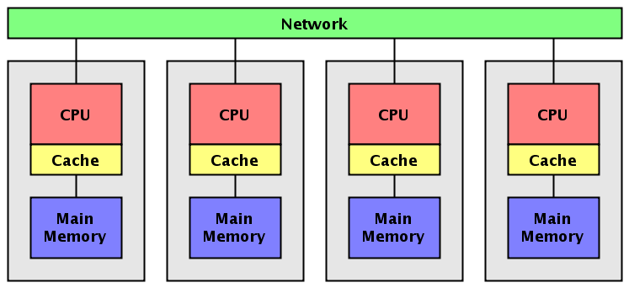
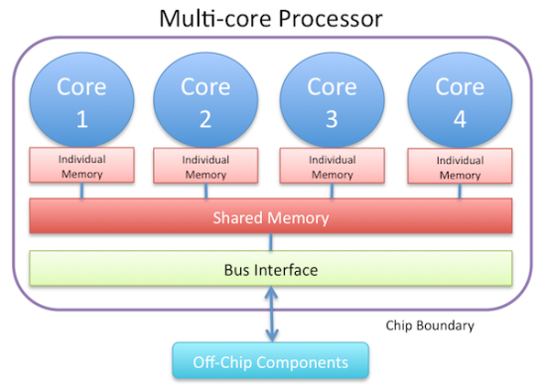
Parallel Computers
Price
Supercomputers
Clusters
Source: http://intelligent-future.com/wp/?p=480
Source: http://www.cs.rit.edu/~ark/lectures/pj04/notes.shtml
Chip multiprocessors
Source: http://blog.tinydeal.com/2012/10/21/a-recommend-of-a-quad-core-pc-in-td-l-117295-2/
Notes:
Chip multiprocessors ---- relatively inexpensive desktop and laptop chip multiprocessors contain a single multicore integrated-circuit chip that houses multiple processing “cores”, each of which is a full-fledged processor that can access a common memory.
At an intermediate price/performance point are clusters built from indicidual computers --- often simple PC-class machines --- with a dedicated network interconnecting them.
The highest-priced machines are supercomputers, which often use a combination of custom architectures and custom networks to deliver the highest performance in terms of instructions executed per second.

Slide 3
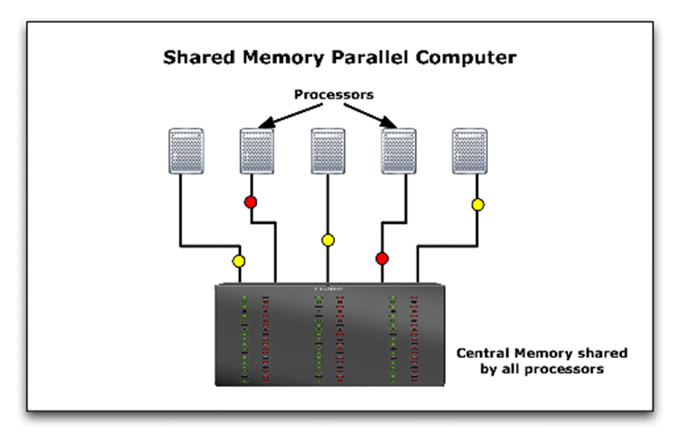
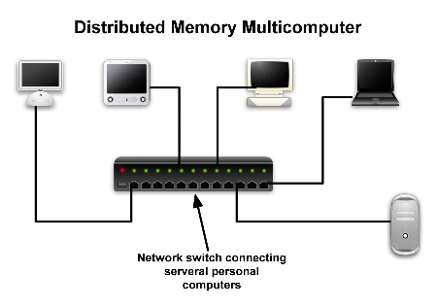
Multiprocessor Computers
Shared memory
Distributed memory
Source: http://www.cfd-online.com/Wiki/Parallel_computing
Notes:
With the advent of multicore technology, every new laptop and desktop machine is now a shared-memory parallel computer, and the trend appears to be toward shared-memory multiprocessing.

Slide 4
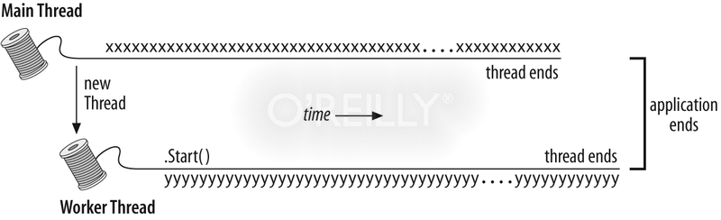
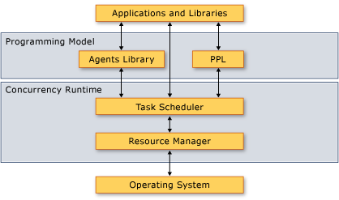
Programming Chip Multiprocessors and Shared-memory Parallel Computers
Static threading
Concurrency platform
Source: http://msdn.microsoft.com/en-us/library/orm-9780596527570-03-19.aspx
Source: http://msdn.microsoft.com/en-us/library/ee207192.aspx

Slide 5
Concurrency Platform
Why do we need it?
Programming a shared-memory parallel computer directly using static threads is difficult and error-prone.
Dynamically partitioning the work among the threads so that each thread receives approximately the same load turns out to be a complicated undertaking.
Provides a layer of software that coordinates, schedules, and manages the parallel-computing resources.

Slide 6
Introduction
One of the most important classes of concurrency platforms/Models
Allows programmers to specify parallelism in applications without worrying about communication protocols, load balancing, and other vagaries of static-thread programming
Contains a scheduler
Supports two features (the basis of the model):
Nested parallelism
Parallel loops

Slide 7
Nested Parallelism
Allows a subroutine to be “spawned”, allowing the caller to proceed while the spawned subroutine is computing its results

Slide 8
Parallel Loop
A parallel loop is like an ordinary for loop, except that the iterations of the loop can execute concurrently.

Slide 9

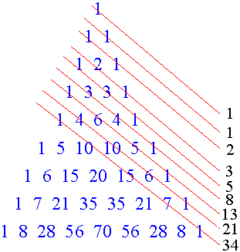
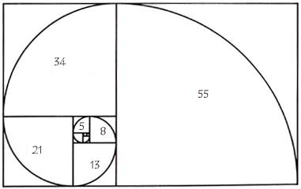

The basic of dynamic multithreading
An example: the Fibonacci number
http://www.maplesoft.com/applications/view.aspx?SID=3617&view=html
http://www.creationoutreach.com/id108.html
http://whofortedblog.com/2009/10/25/the-fibonacci-sequence-blueprint-of-intelligent-design/

Slide 10
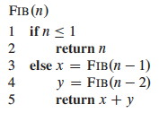
Recursive, serial algorithm to compute the nth Fibonacci number
FIB(4)
FIB(3)
FIB(2)
T(n)=Θ(ɸ^n)
ɸ=(1+5^0.5)/2
This grows exponentially in n, so it's not very efficient.
FIB(2)
FIB(1)
FIB(1)
FIB(0)
FIB(1)
FIB(0)
Notes:
The tree of recursive procedure instances when computing FIB(4). Each instance of FIB with the same argument does the same work to produce the same result, providing an inefficient but interesting way to compute Fibonacci numbers.

Slide 11
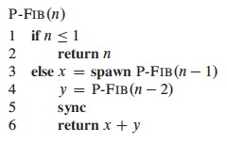
Concurrency Keywords: Spawn and Sync
Notes:
Noticing that the recursive calls operate independently of each other, let's see what improvement we can get by computing the two recursive calls in parallel. This will illustrate the concurrency keywords and also be an example for analysis:
Notice that without the keywords it is still a valid serial program.
Logical Parallelism:
The spawn keyword does not force parallelism: it just says that it is permissible. A scheduler will make the decision concerning allocation to processors.
However, if parallelism is used, sync must be respected. For safety, there is an implicit sync at the end of every procedure.
We will return to this example when we analyze multithreading.

Slide 12
Spawn vs. Ordinary Procedure Call
Spawn: the procedure instances that execute the spawn --- the parent – may continue to execute in parallel with the spawned subroutine – its child.
Ordinary procedure call: waiting for the child to complete
Notes:
In this case, while the spawned child is computing P-FIB(n-1), the parent may go on to compute P-FIB(n-2) in line 4 in parallel with the spawned child.
Since the P-FIB procedure is recursive, these two subroutine calls themselves create nested parallelism , as do their children, thereby creating a potentially vast tree of subcomputation , all executing in parallel.

Slide 13
A Model for Dynamic Multithreading
Computation dag (Directed Acyclic Graph)
G = (V, E);
Vertices in V are instructions, or strands = sequences of non-parallel instructions.
Strand: a chain of instructions contains no parallel control.
Edges in E represent dependencies between instructions or strands:
(u, v) ∈ E means u must execute before v.
---strand

Slide 14
Procedure Tree
P-FIB(4)
P-FIB(3)
P-FIB(2)
P-FIB(2)
P-FIB(1)
P-FIB(1)
P-FIB(0)
P-FIB(1)
P-FIB(0)

Slide 15
Constructing a directed acyclic graph representing the computation of P-FIB(4)
Each circle represents one strand.
Continuation edges point horizontally to the right.

Slide 16
Constructing a directed acyclic graph representing the computation of P-FIB(4)
FIB(4)
Each group of strands belonging to the same procedure is surrounded by a rounded rectangle.
Each circle represents one strand.

Slide 17
Constructing a directed acyclic graph representing the computation of P-FIB(4)
FIB(4)
Call edge
Spawn edge
Return edge
FIB(3)
FIB(2)
Spawn edges and call edges point downward.
Return edges point upward.

Slide 18
Constructing a directed acyclic graph representing the computation of P-FIB(4)
FIB(4)
FIB(4)
FIB(3)
FIB(3)
FIB(2)
FIB(2)
FIB(2)
FIB(1)
FIB(1)
FIB(0)
FIB(1)
FIB(0)

Slide 19
Procedure tree
FIB(4)
FIB(4)
FIB(4)
FIB(3)
FIB(3)
FIB(3)
FIB(2)
FIB(2)
FIB(2)
FIB(2)
FIB(2)
FIB(0)
FIB(1)
FIB(0)
FIB(1)
FIB(1)
FIB(1)
FIB(1)
FIB(0)

Slide 20
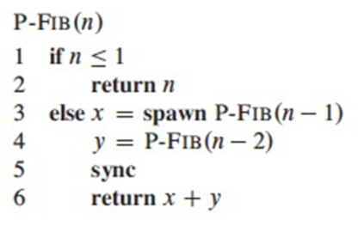
Constructing a directed acyclic graph representing the computation of P-FIB(4)
Initial strand
Black circles : base cases or the part of the procedure (instances) up to the spawn of P-FIB(n-1) in line 3
Shaded circles: the part of the procedure that calls P-FIB(n-2) in line 4
FIB(4)
FIB(4)
FIB(4)
FIB(3)
FIB(3)
FIB(3)
FIB(2)
FIB(2)
FIB(2)
FIB(2)
FIB(2)
FIB(0)
FIB(1)
FIB(0)
FIB(1)
FIB(1)
FIB(1)
Final strand
White circles: the part of the procedure after the sync where it sums x and y up to the point where it returns the results, see Line 6 of P-FIB(n-1).
FIB(1)
FIB(0)

Slide 21
Constructing a directed acyclic graph representing the computation of P-FIB(4)
Heavily shaded for called procedures
Lightly shaded for spawned procedures
FIB(4)
FIB(4)
FIB(4)
FIB(3)
FIB(3)
FIB(3)
FIB(2)
FIB(2)
FIB(2)
FIB(2)
FIB(2)
FIB(0)
FIB(1)
FIB(0)
FIB(1)
FIB(1)
FIB(1)
FIB(1)
FIB(0)

Slide 22
Constructing a directed acyclic graph representing the computation of P-FIB(4)
For any strand u1 to strand u2 in G, if there is a directed path from u1 to u2, we say that two strands are (logically) in series, otherwise, strands u1 and u2 are (logically) in parallel.
FIB(4)
FIB(4)
FIB(4)
FIB(3)
FIB(3)
FIB(3)
FIB(2)
FIB(2)
FIB(2)
FIB(2)
FIB(2)
FIB(0)
FIB(1)
FIB(0)
FIB(1)
FIB(1)
FIB(1)
u2
u1
FIB(1)
FIB(0)
u1
u2

Slide 23
Performance measure: The Concepts of Work and Span
Let P be the number of processors
First analyze two extreme cases P= 1 and P = ∞:
Work (T1): the work of a multithreaded computation is the total time to execute the entire computation on one processor (assuming that we have one processor).
The sum of the times taken by each of the strands.
Span (T∞): the longest time to execute the strands along any path in the dag.
For a dag in which each strand takes unit time, the span equals the number of vertices on a longest or critical path in the dag.

Slide 24
Constructing a directed acyclic graph representing the computation of P-FIB(4)
Critical path
FIB(4)
FIB(4)
FIB(4)
FIB(3)
FIB(3)
FIB(3)
FIB(2)
FIB(2)
FIB(2)
FIB(2)
FIB(2)
FIB(0)
FIB(1)
FIB(0)
FIB(1)
FIB(1)
FIB(1)
Assuming that each strand takes unit time, the work equals 17 time units, since there are 17 strands, and the span is 8 time units, since the critical path – shown with shaded edges --- contains 8 strands.
FIB(1)
FIB(0)

Slide 25
Constructing a directed acyclic graph representing the computation of P-FIB(4)
Critical path
FIB(4)
FIB(3)
FIB(2)
FIB(2)
FIB(0)
FIB(1)
FIB(0)
FIB(1)
FIB(1)
FIB(1)
Assuming that each strand takes unit time, the work equals 17 time units, since there are 17 strands, and the span is 8 time units, since the critical path – shown with shaded edges --- contains 8 strands.
FIB(1)
FIB(0)

Slide 26
Constructing a directed acyclic graph representing the computation of P-FIB(4)
Critical path
t1
t2
t3
t4
t6
t14
t5
t15
t13
t7
t8
t16
t17
t9
FIB(1)
FIB(0)
t12
t10
t11

Slide 27
Constructing a directed acyclic graph representing the computation of P-FIB(4)
Critical path
t1
t2
t3
t4
t6
t14
t5
t15
t13
t7
t8
t16
t17
t9
FIB(1)
FIB(0)
t12
T1 (Work) = the number of the set:
{ t1, t4, t7, t10, t8, t11, t9, t5, t12, t6, t2, t13, t16, t14, t17, t15, t3}
= 17
t10
t11

Slide 28
Two Laws: Work Law and Span Law
For an ideal parallel computer with P processors,
In one step, it can do at most P units of work, and thus in TP time, it can perform at most PTP work. Since the total work to do is T1, so we have PTP≥T1. Divided by P yields the work law:
TP ≥ T1/P
It cannot run any faster than a machine with an unlimited number of processors. Thus, the span law follows:
TP ≥ T∞
Notes:
TP ≥ T1/P （P个人平均分配时，最省时间）
TP ≥ T∞ (人越多，越快完成任务）

Slide 29

Actual Running Time with P Processors
Critical path
t1
t2
t3
t4
t5
t6
t14
t15
t13
t7
t8
t16
t17
t9
FIB(1)
FIB(0)
Assume P= 1
t12
t10
t11
Processor 1:
Step: 1 2 3 4 5 6 7 8 9 10 11 12 13 14 15 16 17
t1
t4
t7
t10
t8
t11
t9
t5
t12
t6
t2
t13
t16
t14
t17
t15
t3
Waiting: t2 t2 t2 t2 t2 t2 t2 t2 t2 t14
t5 t5 t5 t5 t5
t8
T1 = 17

Slide 30
Actual Running Time with P Processors
Critical path
t1
t2
t3
t4
t5
t6
t14
t15
t13
t7
t8
t16
t17
t9
FIB(1)
FIB(0)
Assume P= 1
t12
t10
t11
Processor 1
Processor 2
Processor 3
Processor 4
Processor 5
….
t1
t2
t13
t14
t15
t15
t3
t4
t5
t10
t17
t7
t8
t11
t9
t6
t12
t16
No waiting strands:
T∞ = 8
Red strands form a critical path

Slide 31
Actual Running Time with P Processors
Critical path
t1
t2
t3
t4
t5
t6
t14
t15
t13
t7
t8
t16
t17
t9
FIB(1)
FIB(0)
Assume P=3
t12
t10
t11
Step: 1 2 3 4 5 6 7 8
Processor 1
Processor 2
Processor 3
t1
t2
t13
t14
t16
t17
t15
t3
t4
t5
t10
t12
t7
t8
t11
t9
t6
t16
t12
t17
Waiting strands:
PxTP = 24 > T1 = 17
T3 = 8

Slide 32
Speedup
Speedup of a computation on P processors by the ratio: T1/TP.
It says how many times faster the computation is on P processors than on 1 processor.
T1/TP ≤ P
The speedup on P processors can be at most P
Linear speedup: when the speedup is linear in the number of processors, that is, when T1/TP = Θ(P)
Perfect linear speedup : when T1/TP = P.
Notes:
T1 = 17
P= 3
T3 = 8
T1/T3 = 17/8 = 2.125 < 3 = P.
完全线性加速:
T1 = 24
T3 = 8. then
T1/T8 = 3 = P
p1: _ _ _ _ _ _ _ _
p2: _ _ _ _ _ _ _ _
p3: _ _ _ _ _ _ _ _

Slide 33
Parallelism
Definition: Parallelism = T1/T∞
E.g. In P-FIB(4), parallelism = 17/8 = 2.125
How to understand “parallelism”? Three perspectives
The average amount of work that can be performed in parallel for each step along the critical path.
The maximum possible speedup that can be achieved on any number of processors.
Once the number of processors exceeds the parallelism, the computation cannot possibly achieve perfect linear speedup. In P-FIB(4), achieving much more than double the speedup is impossible.

Slide 34
Parallel Slackness
Definition:
Parallel slackness of a multithreaded computation executed on an ideal parallel computer with P processors to be the ratio:
Parallelism/P = (T1/T∞)/P = T1/(PT∞)
In P-FIB(4), P=3, the parallelism is 2.125, the parallel slackness is 2.125/3 = 0.71
A factor by which the parallelism of the computation exceeds the number of processors in the machine .
If the slackness is less than 1, we cannot hope to achieve perfect linear speedup, because T1/(PT∞)<1 and the span law.
Notes:
Slackness = 松弛的部分

Slide 35
Scheduling
In practice, the scheduler maps the strands to static threads, and the operating system schedules the threads on the processors themselves, but this extra level of indirection is unnecessary for our understanding of scheduling.
We just imagine that the concurrency platform’s scheduler maps strands to processors directly.

Slide 36
Online, Distributed
A multithreaded scheduler must schedule the computation with no advance knowledge of when strands will be spawned or when they will complete --- it must operate on-line.
A good scheduler operates in a distributed fashion, where the threads implementing the scheduler cooperate to load-balance the computation.
Analyzing them is complicated!

Slide 37
Centralized scheduler
To keep our analysis simple, we shall investigate an on-line centralized scheduler, which knows the global state of the computation at any given time.
Greedy scheduler --- assign as many strands to processors as possible in each time step.
Complete step: if at least P strands are ready to execute during a time step, we say that the step is complete step;
A greedy scheduler assigns any P of the ready strands to processors.
Otherwise, fewer than P strands are ready to execute, in which case we say that the step is an incomplete step, and the scheduler assigns each ready strand to its own processor.

Slide 38
Complete steps
P=3
Processor 1
Processor 2
Processor 3
t1
t2
t13
t14
t16
t17
t15
t3
t4
t5
t10
t12
t7
t8
t11
t9
t6
t16
t12
t17
Waiting strands:
T3 = 8
∟T1/3┘ = ∟ 17/3 ┘ = ∟ 5.67 ┘=5
T∞ = 8
Incomplete steps

Slide 39
Theorem: Upper Bound of Greedy Scheduling
We have : T∞ ≤ TP ; and T1/P ≤ TP
Work law: the best running we can hope for on P processors is: TP = T1/P
Span law: the best we can hope for is TP = T∞
In P-FIB(4), T3 = 8, T1/P = 17/3 = 5.67, T∞=8
On an ideal parallel computer with P processors, a greedy scheduler executes a multithreaded computation with work T1 and T∞ in time
TP ≤ T1/P+T∞

Slide 40
The relation between P and TP
y
y = T1/x + T∞
T1
T2
T3
T4
y = T1/x
(P, TP)
TP
T1/P
T∞
T∞
(P, T1/P)
T∞
T1/P
T∞
x
1 2 3 4 P ∞

